Slide 1

GUI
by Oleksii Kryvonosov

Slide 2
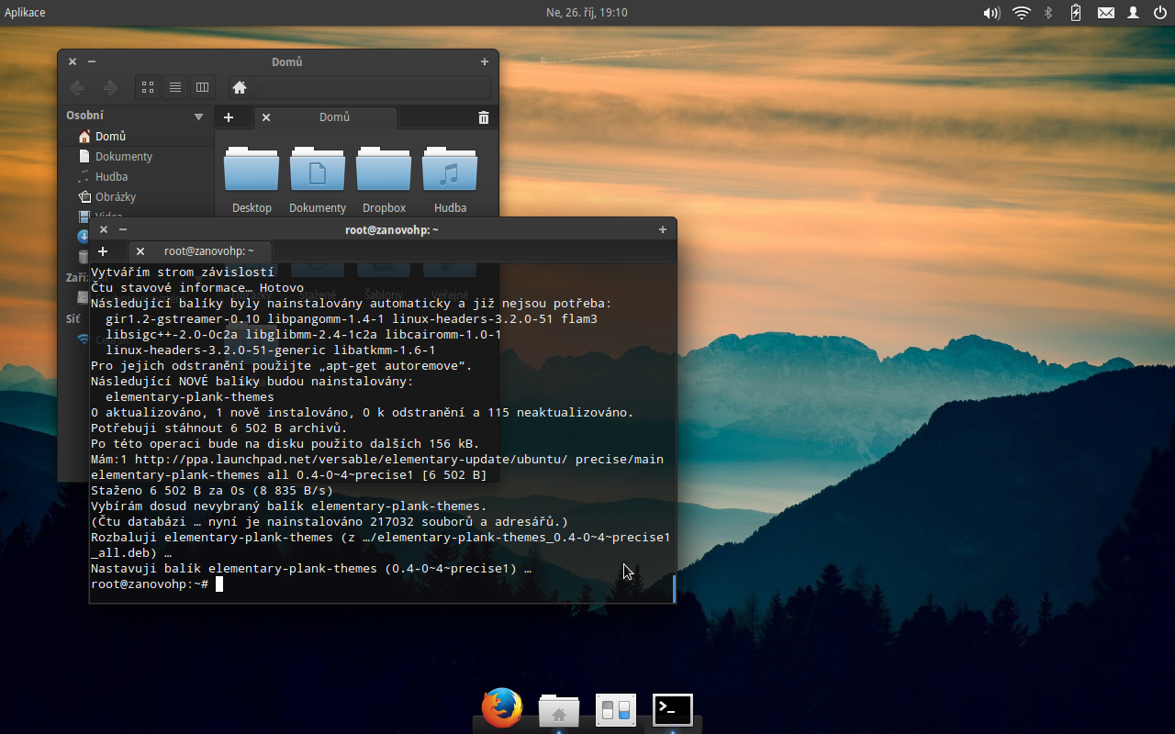

Slide 3

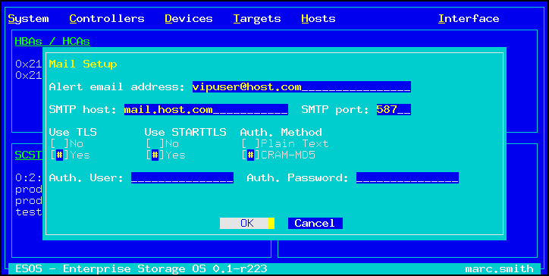
graphical character-based user
interface

Slide 4



OR?

Slide 5
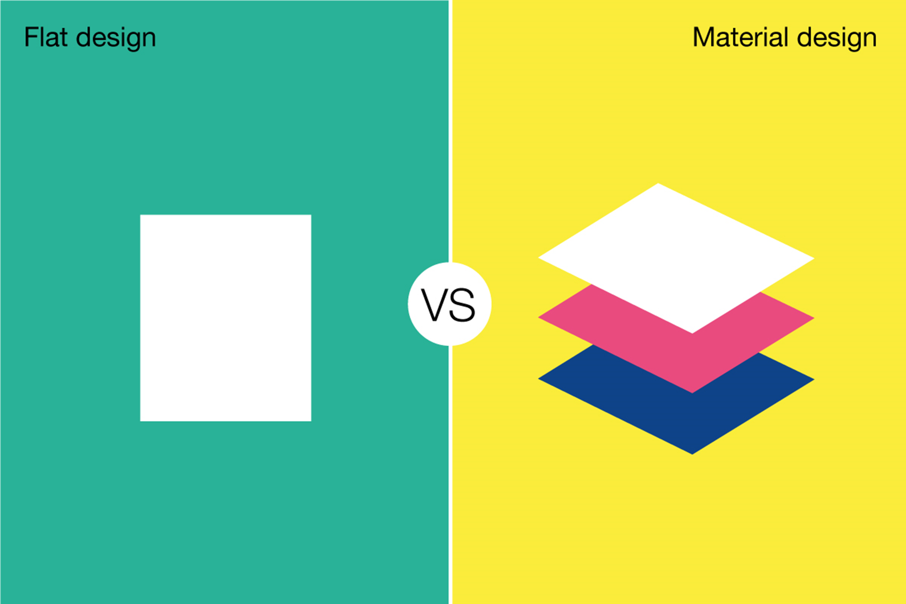

Slide 6

Flat Design

Slide 7

Material Design

Slide 8

